Slide 1
Welcome to Fontan Education Day
We will begin in a few minutes…

Slide 2
Welcome/Intro
As we are affiliated with the University of British Columbia, we would like to acknowledge that UBC Vancouver is situated on the traditional, ancestral, unceded territory of the xwməθkwəy̓əm (Musqueam) Nation.
Visit Native Land to find out where you are joining us from:
https://native-land.ca/

Slide 3
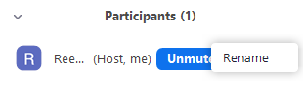
Zoom Functions
Rename yourself:

Slide 4
Zoom Functions
Audio/Video
Chat

Slide 5
Zoom Functions
Raise hand and reactions (emojis) for Breakout Sessions:

Slide 6
Zoom Functions
Live captioning:

Slide 7
Housekeeping
Graphic Recording
If you need help:
Using the Zoom Chat, send a direct message to: 🛠 TECH-HOST - ERM

Slide 8
Agenda
Welcome & Introduction | 9:00 - 9:05
Icemelter | 9:05 - 9:10
Understanding the Fontan Operation & CANFON | 9:10 - 9:20
Late Health Considerations | 9:20 - 9:35
Lifestyle Considerations | 9:35 - 9:50
Brain Health | 9:50 - 9:55
Break | 9:55 - 10:05
Breakout Rooms 1 & 2 | 10:05 - 10:55
Break | 10:55 - 11:05
Breakout Rooms 3 & 4 | 11:05 - 11:55
Wrap Up & Resources | 11:55 - 12:00
Open Q & A | 12:00

Slide 9
Icemelter
Options for joining the Icemelter (via Slido):
QR Code:
Open the camera app on your mobile device and place it over the the QR code on the next slide. A link or url should appear - click on it to follow and join our Slido Icemelter.
Link:
Type in slido.com into a new browser tab or window, such as Chrome.
Type in the event’s code to join: #576212
Pen & Paper:
Follow along with pen & paper but note that your answers will not populate on the screen.

Slide 10
Join at slido.com #576212
ⓘ Start presenting to display the joining instructions on this slide.
Notes:
📣 This is Slido interaction slide, please don't delete it. ✅ Click on 'Present with Slido' and the joining instructions will appear when you get to this slide.

Slide 11
What city are you joining us from today? OR What hospital/CHD clinic are you with?
ⓘ Start presenting to display the poll results on this slide.
Notes:
📣 This is Slido interaction slide, please don't delete it. ✅ Click on 'Present with Slido' and the poll will launch automatically when you get to this slide.

Slide 12
If you could have any superpower, what would it be?
ⓘ Start presenting to display the poll results on this slide.
Notes:
📣 This is Slido interaction slide, please don't delete it. ✅ Click on 'Present with Slido' and the poll will launch automatically when you get to this slide.

Slide 13
If you could travel anywhere right now, where would you go?
ⓘ Start presenting to display the poll results on this slide.
Notes:
📣 This is Slido interaction slide, please don't delete it. ✅ Click on 'Present with Slido' and the poll will launch automatically when you get to this slide.

Slide 14
Have you ever met another Fontan patient in person before?
ⓘ Start presenting to display the poll results on this slide.
Notes:
📣 This is Slido interaction slide, please don't delete it. ✅ Click on 'Present with Slido' and the poll will launch automatically when you get to this slide.

Slide 15
How many children are born with CHD worldwide each year?
ⓘ Start presenting to display the poll results on this slide.
Notes:
📣 This is Slido interaction slide, please don't delete it. ✅ Click on 'Present with Slido' and the poll will launch automatically when you get to this slide.

Slide 16
What celebrity was born with CHD?
ⓘ Start presenting to display the poll results on this slide.
Notes:
📣 This is Slido interaction slide, please don't delete it. ✅ Click on 'Present with Slido' and the poll will launch automatically when you get to this slide.

Slide 17
Like humans, CHD is commonly found in dogs
ⓘ Start presenting to display the poll results on this slide.
Notes:
📣 This is Slido interaction slide, please don't delete it. ✅ Click on 'Present with Slido' and the poll will launch automatically when you get to this slide.

Slide 18
CHD is the world’s leading birth defect
ⓘ Start presenting to display the poll results on this slide.
Notes:
📣 This is Slido interaction slide, please don't delete it. ✅ Click on 'Present with Slido' and the poll will launch automatically when you get to this slide.

Slide 19
Approximately how many Canadian children are born with CHD every year?
ⓘ Start presenting to display the poll results on this slide.
Notes:
📣 This is Slido interaction slide, please don't delete it. ✅ Click on 'Present with Slido' and the poll will launch automatically when you get to this slide.

Slide 20
In what year was the first Fontan surgery completed?
ⓘ Start presenting to display the poll results on this slide.
Notes:
📣 This is Slido interaction slide, please don't delete it. ✅ Click on 'Present with Slido' and the poll will launch automatically when you get to this slide.

Slide 21
Understanding the Fontan Operation & Canadian Fontan Registry CANFON
Dr. Jasmine Grewal MD, FRCPC
Professor, University of British Columbia
Director, Virani Provincial Adult Congenital Heart Program
Vancouver, B.C.
Notes:
I would like to thank the organizers for inviting me to fomrally present the Canadian Fontan Regisry on behalf of the CANFON Investigators.

Slide 22
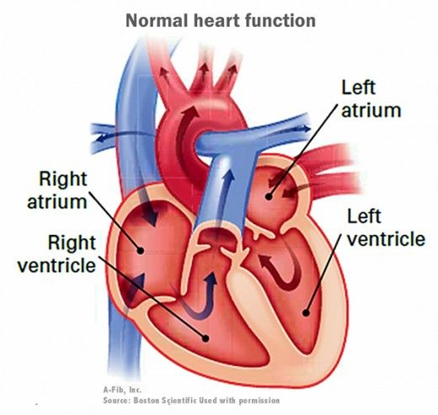
“Normal” Heart

Slide 23
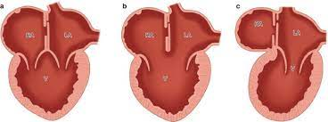
Univentricular Heart
RA
RA
RA
LA
RA
LA
LA
LA
V
V
V
V
Tricuspid Atresia
Hypoplastic left heart syndrome
Unbalanced atrio-ventricular septal defect
Double outlet right ventricle
Double inlet left ventricle
Pulmonary atresia

Slide 24
Univentricular Heart
1 in every 3000 children born in North America
Similar prevalence to CYSTIC FIBROSIS (1/3600)
Very poor prognosis with over 70% of individuals dying by 16 years of age
(if unrepaired)
Notes:
It is estimated that one in every 3000 children born in North America has a univentricular heart and at least 80% undergo Fontan surgery¹⁻³ (References in Appendix 1). Without Fontan surgery, children with an unrepaired univentricular heart have a very poor prognosis with over 70% dying by 16 years of age⁴. The Fontan surgery has revolutionized the care of these patients by significantly improving survival and remains the best option⁵. The Fontan operation is relatively new, first introduced in the 1970s, and therefore there is minimal outcomes data and no prospective data extending beyond 20 years.

Slide 25
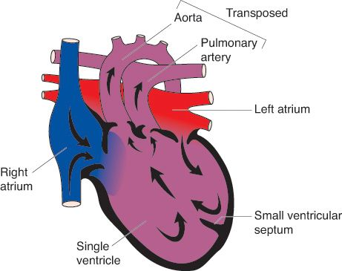
The Problem?
SVC
IVC
Notes:
It is estimated that one in every 3000 children born in North America has a univentricular heart and at least 80% undergo Fontan surgery¹⁻³ (References in Appendix 1). Without Fontan surgery, children with an unrepaired univentricular heart have a very poor prognosis with over 70% dying by 16 years of age⁴. The Fontan surgery has revolutionized the care of these patients by significantly improving survival and remains the best option⁵. The Fontan operation is relatively new, first introduced in the 1970s, and therefore there is minimal outcomes data and no prospective data extending beyond 20 years.

Slide 26
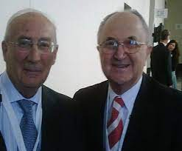
Surgical Progress
Notes:
80% now undergo a Fontan. It involves diverting the venous blood from the right atrium to the pulmonary arterieswithout passing through the morphologic right ventricle. It was initially described in 1971 by Dr. Francois Marie Fontan (1929 – ) from Bordeaux, France and Dr Guillermo Kreutzer from Buenos Aires, Argentina(1934 – ) separately as a surgical treatment for tricuspid atresia.^{[1]} ^{[2]} The Fontan procedure has more recently been used in pediatric situations where an infant only has a single effective ventricle, either due to lack of a heart valve (e.g. tricuspid ormitral atresia), an abnormality of the pumping ability of the heart (e.g. hypoplastic left heart syndrome or hypoplastic right heart syndrome), or a complex congenital heart disease where a bi-ventricular repair is impossible or inadvisable. Fontan was the first to completely bypass the right heart in a human subject and to channel both the IVC and SVC blood to the pulmonary arteries. He unsuccessfully attempted to bypass the right heart in healthy dogs. However, he reasoned that it may work in patients with tricuspid atresia because the right atrium is thicker and more muscular in humans than in canines and hence better able to perform a contractile function. He also believed that valved conduits were essential to prevent the blood from going in the opposite direction (ie, into the IVC). Therefore, he incorporated one valved homograft between the IVC and the right atrium and another valved homograft between the right atrium and the left pulmonary artery.
The final operation consisted of the classic Glenn SVC–to–right pulmonary artery operation as well as the right atrium–to–left pulmonary artery connection with the 2 homografts, as described. He published his results from the first three patients in 1971.^{[2]}
Kreutzer et al (1973) offered a modification almost immediately.^{[4]} They described a connection between the right atrial appendage and the main pulmonary artery accomplished by means of a pulmonary homograft or the patient's own pulmonary annulus but without a valved homograft at the IVC–right atrial junction. In this situation, the continuity of the pulmonary arteries is maintained.

Slide 27
Fontan Operation – Early days
Atrio-pulmonary Fontan
Notes:
This is the first challenge. Creating a circulation compatible with life.

Slide 28
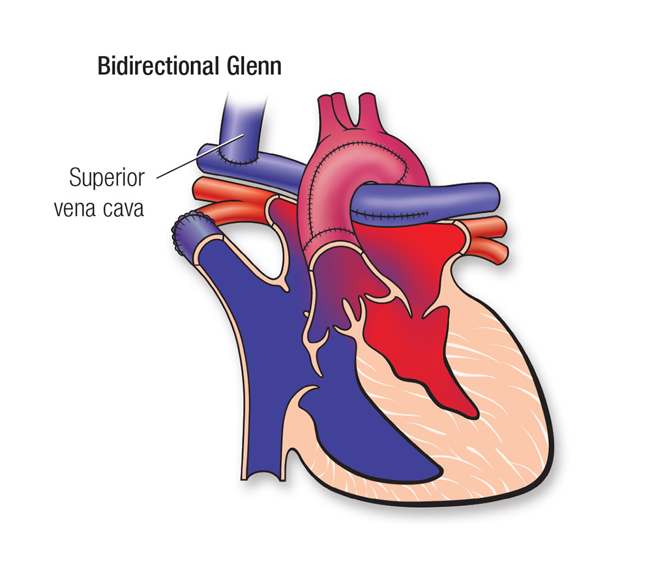
Fontan Operation
Bidirectional Glenn
Notes:
This is the first challenge. Creating a circulation compatible with life.

Slide 29
Fontan Completion
Lateral Tunnel Fontan
Extra-Cardiac Fontan
Notes:
This is the first challenge. Creating a circulation compatible with life.

Slide 30
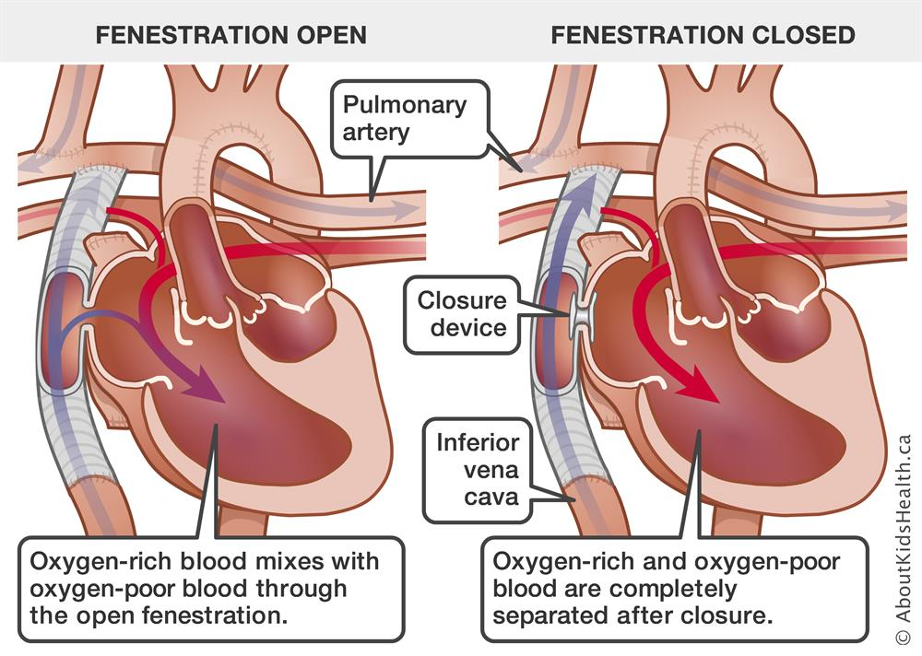
Fontan Fenestration
Lateral Tunnel Fontan
Extra-Cardiac Fontan
Notes:
This is the first challenge. Creating a circulation compatible with life.

Slide 31
Mission
To create a comprehensive lifespan registry of Fontan patients living in Canada
Vision
To support Canadian and International research collaborations that improve the lives of Fontan patients

Slide 32
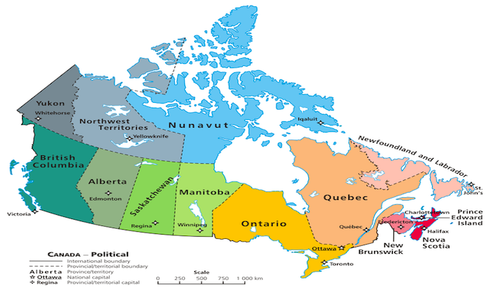
CANFON Canadian Fontan Registry

Slide 33
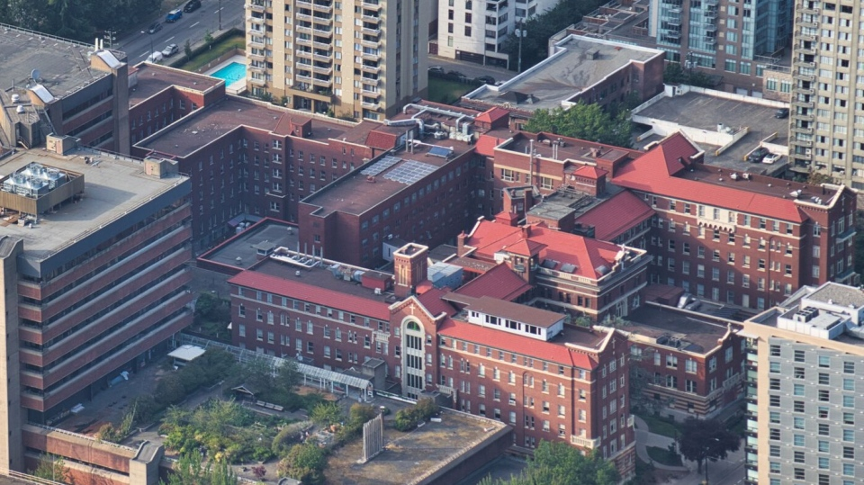
CANFON – Central Coordination
St. Paul’s Hospital, Vancouver, B.C.

Slide 34
CANFON – Data house

Slide 35
CANFON
CANFON Advisory Committee
(Patient and Parent Advocacy)
CANFON Registry
Steering Committee
PATIENTS/FAMILIES
CARE PROVIDERS/RESEARCHERS
Peer to Peer support
Recruitment/Review
Fontan Website
Annual Reports
Fontan Annual Report
International meetings
Fontan Education Days
CACH-Net
CCHA
CPCA
Patient reported outcomes/QOL
CCPCRN/CCI
CCS

Slide 36
Thank you for your time!

Slide 37
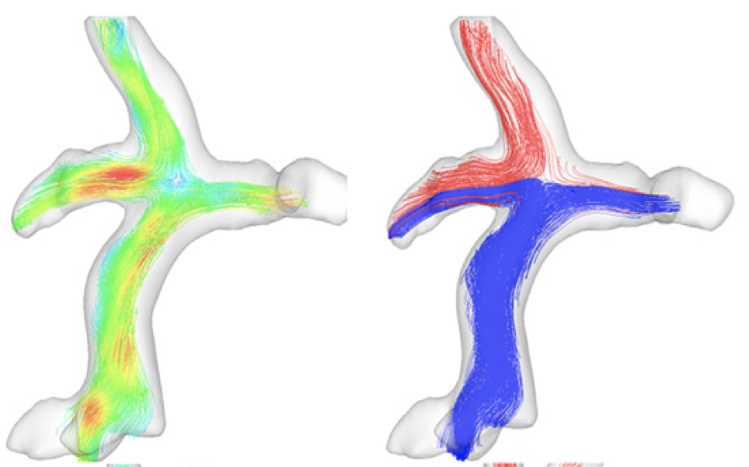
Fontan circulation – late health considerations
Rafael Alonso Gonzalez
Director, Toronto ACHD Program
Assistant professor of Medicine
Peter Munk Cardiac Centre
Toronto - Canada

Slide 38
Diverse morphology
Tricuspid atresia
Dominant left ventricle
Hypoplastic LH syndrome
Dominant right ventricle
Univentricular heart
Single ventricle

Slide 39
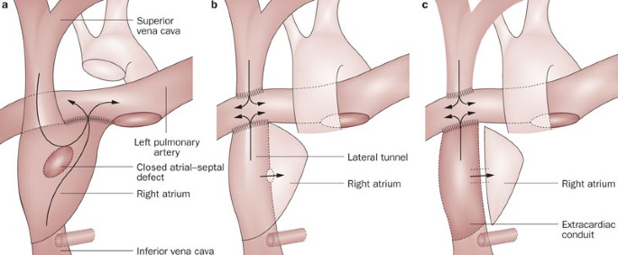
Evolution of Fontan surgery
Total cavo-pulmonary connection
Atrio-pulmonary Fontan
Lateral tunnel
Extra-cardiac conduit

Slide 40
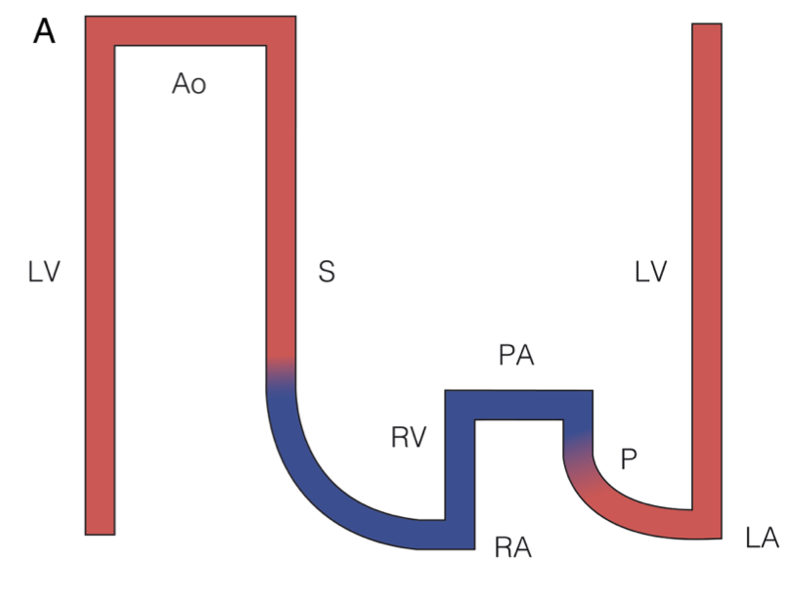
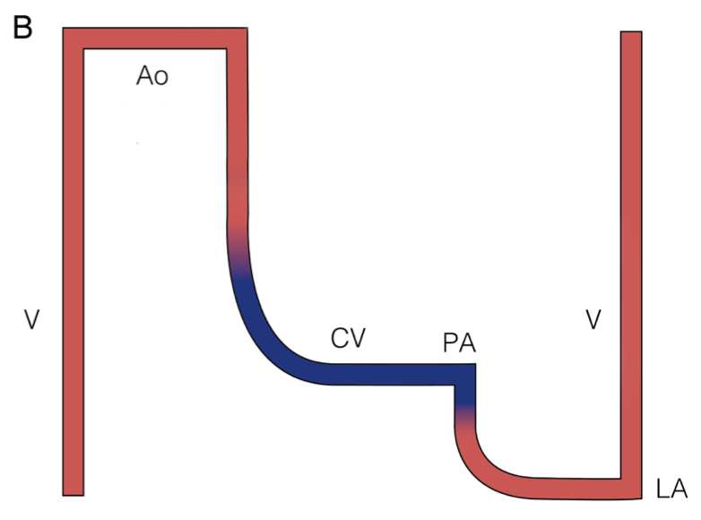
Normal circulation vs Fontan circulation
Normal circulation
Fontan circulation
CO: 100 – 500%
CVP: low
PA: pulsatility
Ao saturation > 95%
CO: 50 – 200%
CVP: high
PA: no pulsatility
Ao saturation 85-95%
Pressure
Pressure
Gewillig M et al. Heart 2016;102:1081-86

Slide 41
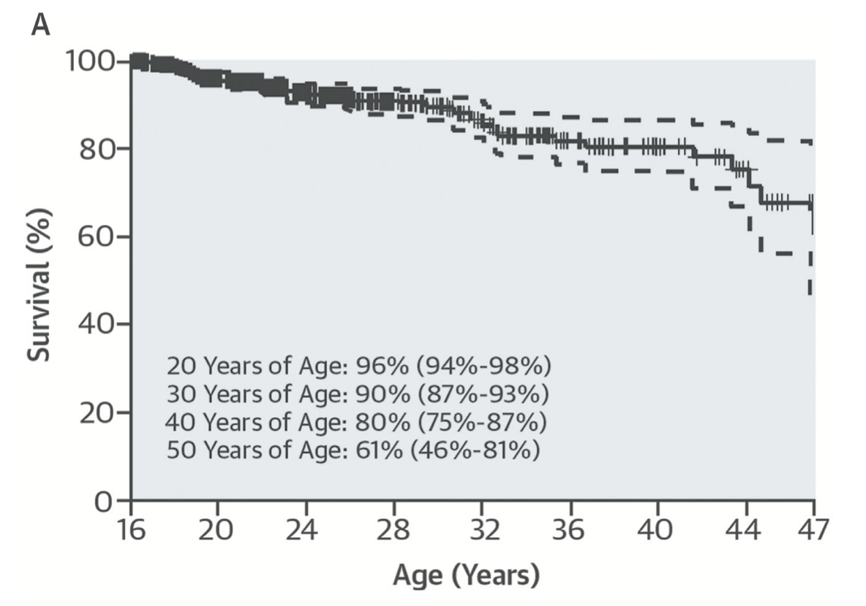
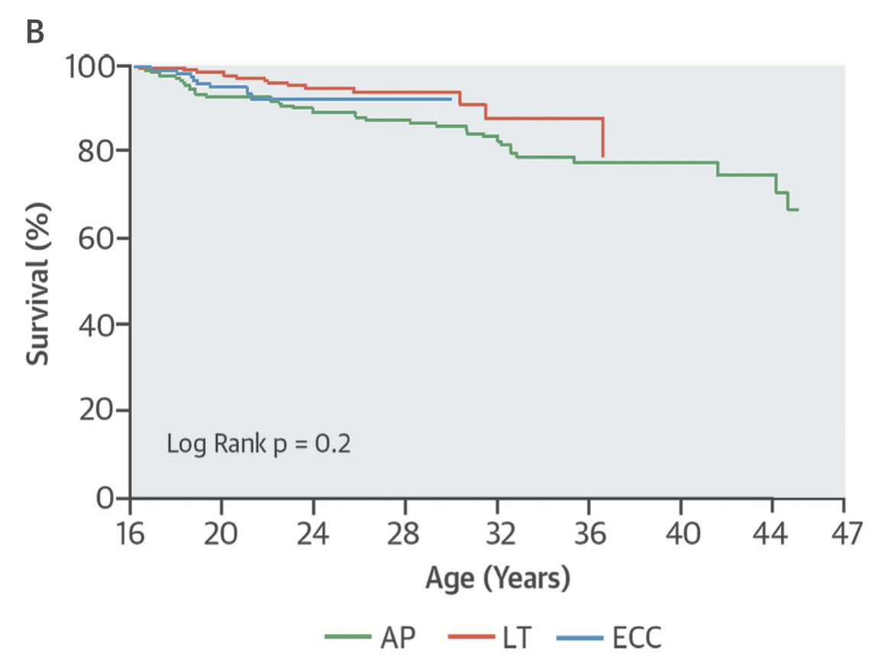
Survival after Fontan surgery

Slide 42
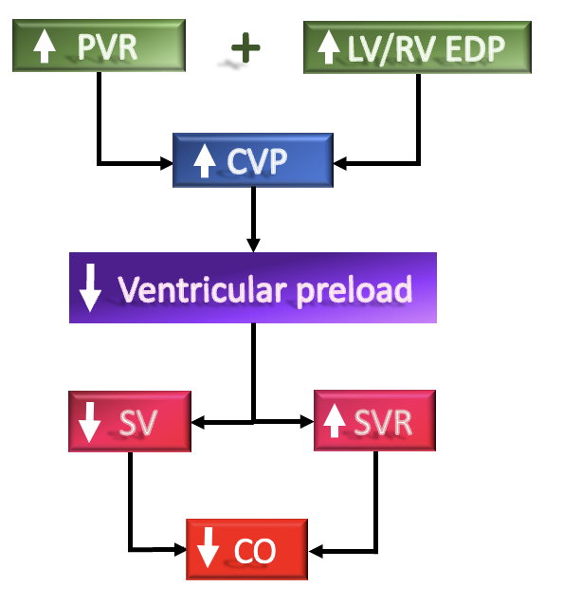
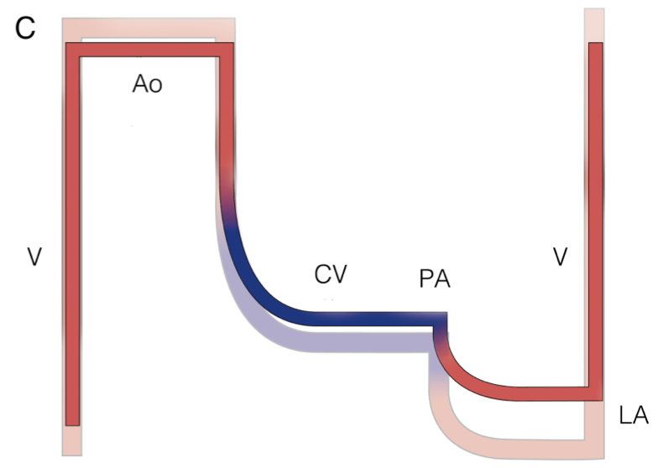
Natural history of Fontan circulation
Late Fontan circulation
Pressure
Gewillig M et al. Heart 2016;102:1081-86

Slide 43
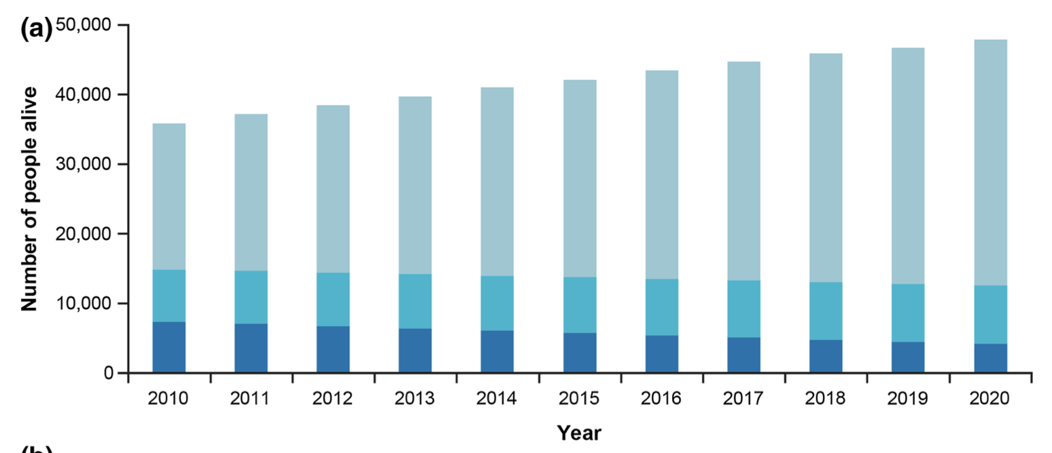
Persons living with Fontan
Plapper L, Adv Ther 2022;39:1004–1015

Slide 44
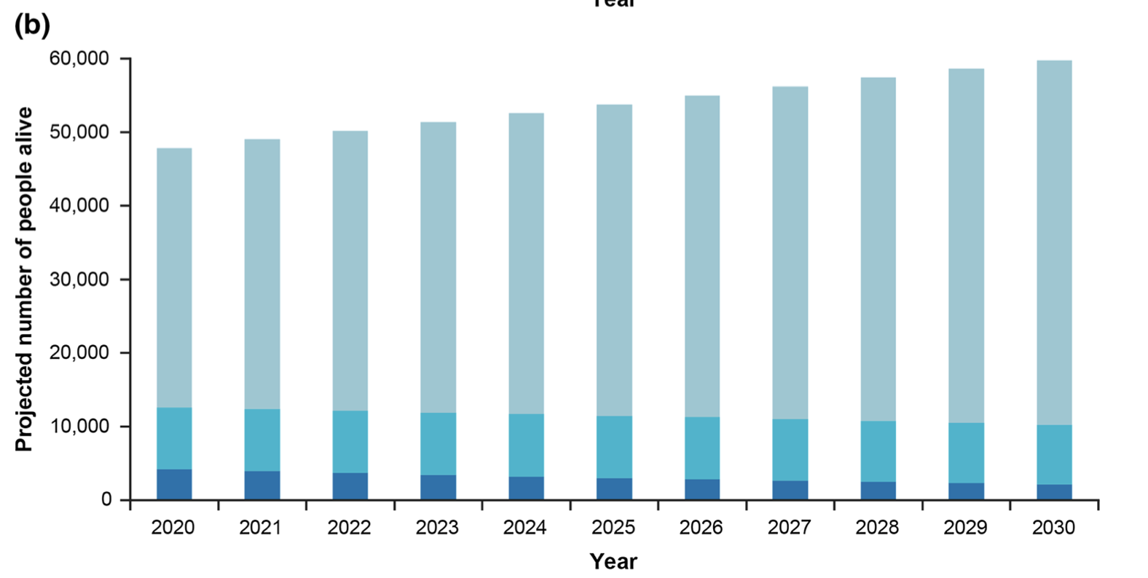
Persons living with Fontan
Plapper L, Adv Ther 2022;39:1004–1015

Slide 45
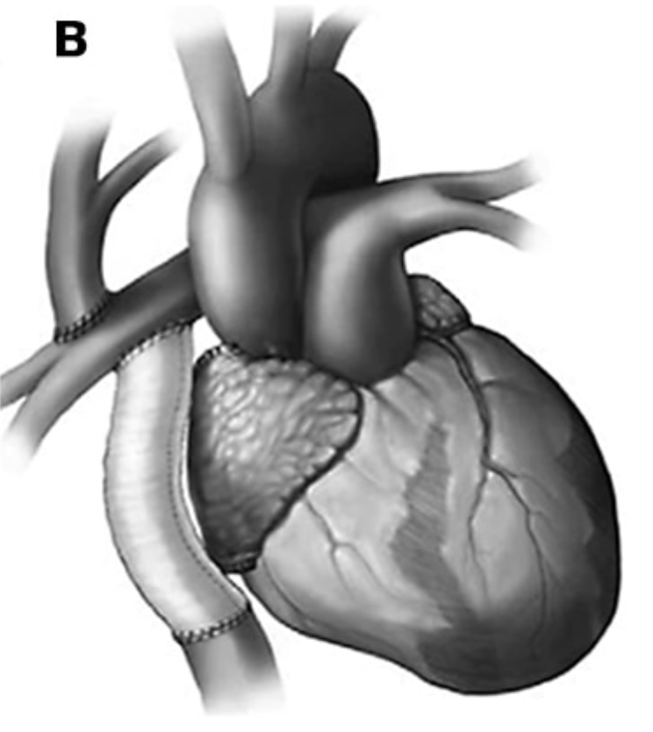
Heart failure
Systolic dysfunction
ECG (yearly)
Echocardiogram (yearly)
Diastolic dysfunction
Holter monitor
(2-3 years)
AV valve regurgitation
CMR/CT
(baseline/2-3 years)
Fontan pressures/Clot
Right heart catheterization
(baseline /5-10 years)
Arrhythmias

Slide 46
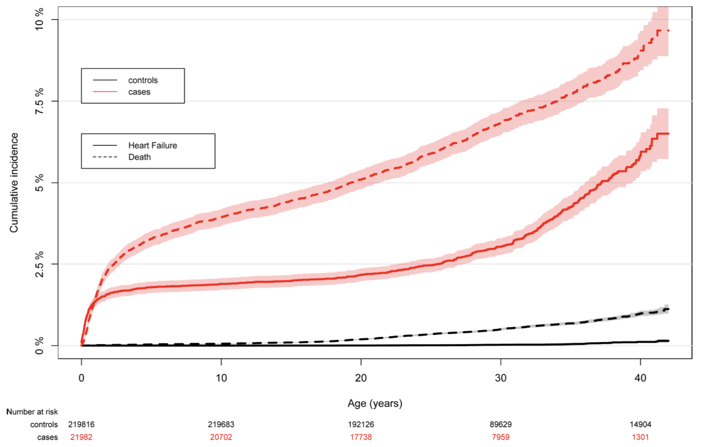
Heart failure
Gilljam T, et al. Open Heart 2019;6:e000858

Slide 47
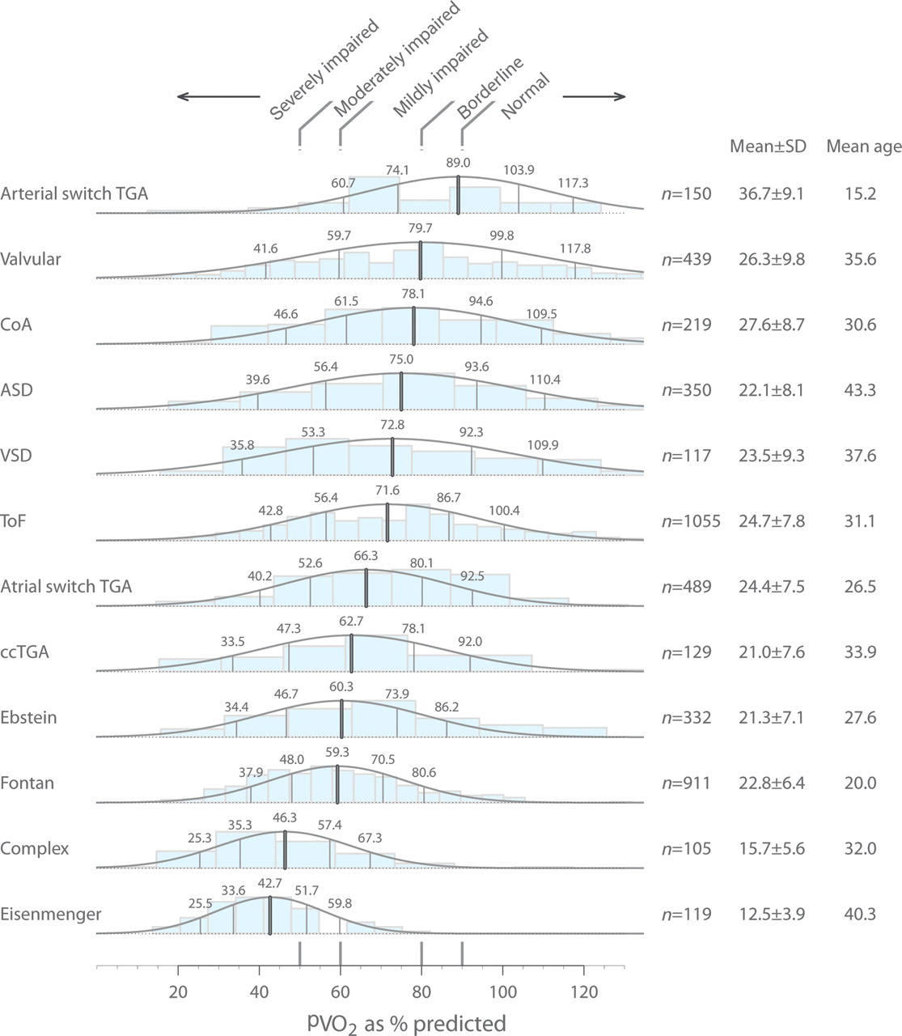
Failing Fontan circulation
Clinical features
Progressive venous congestion
Peripheral oedema
Ascites
Protein-losing enteropathy
Plastic bronchitis
Cyanosis
Exercise intolerance
Kempny et al. Eur Heart J. 201233:1386-96

Slide 48
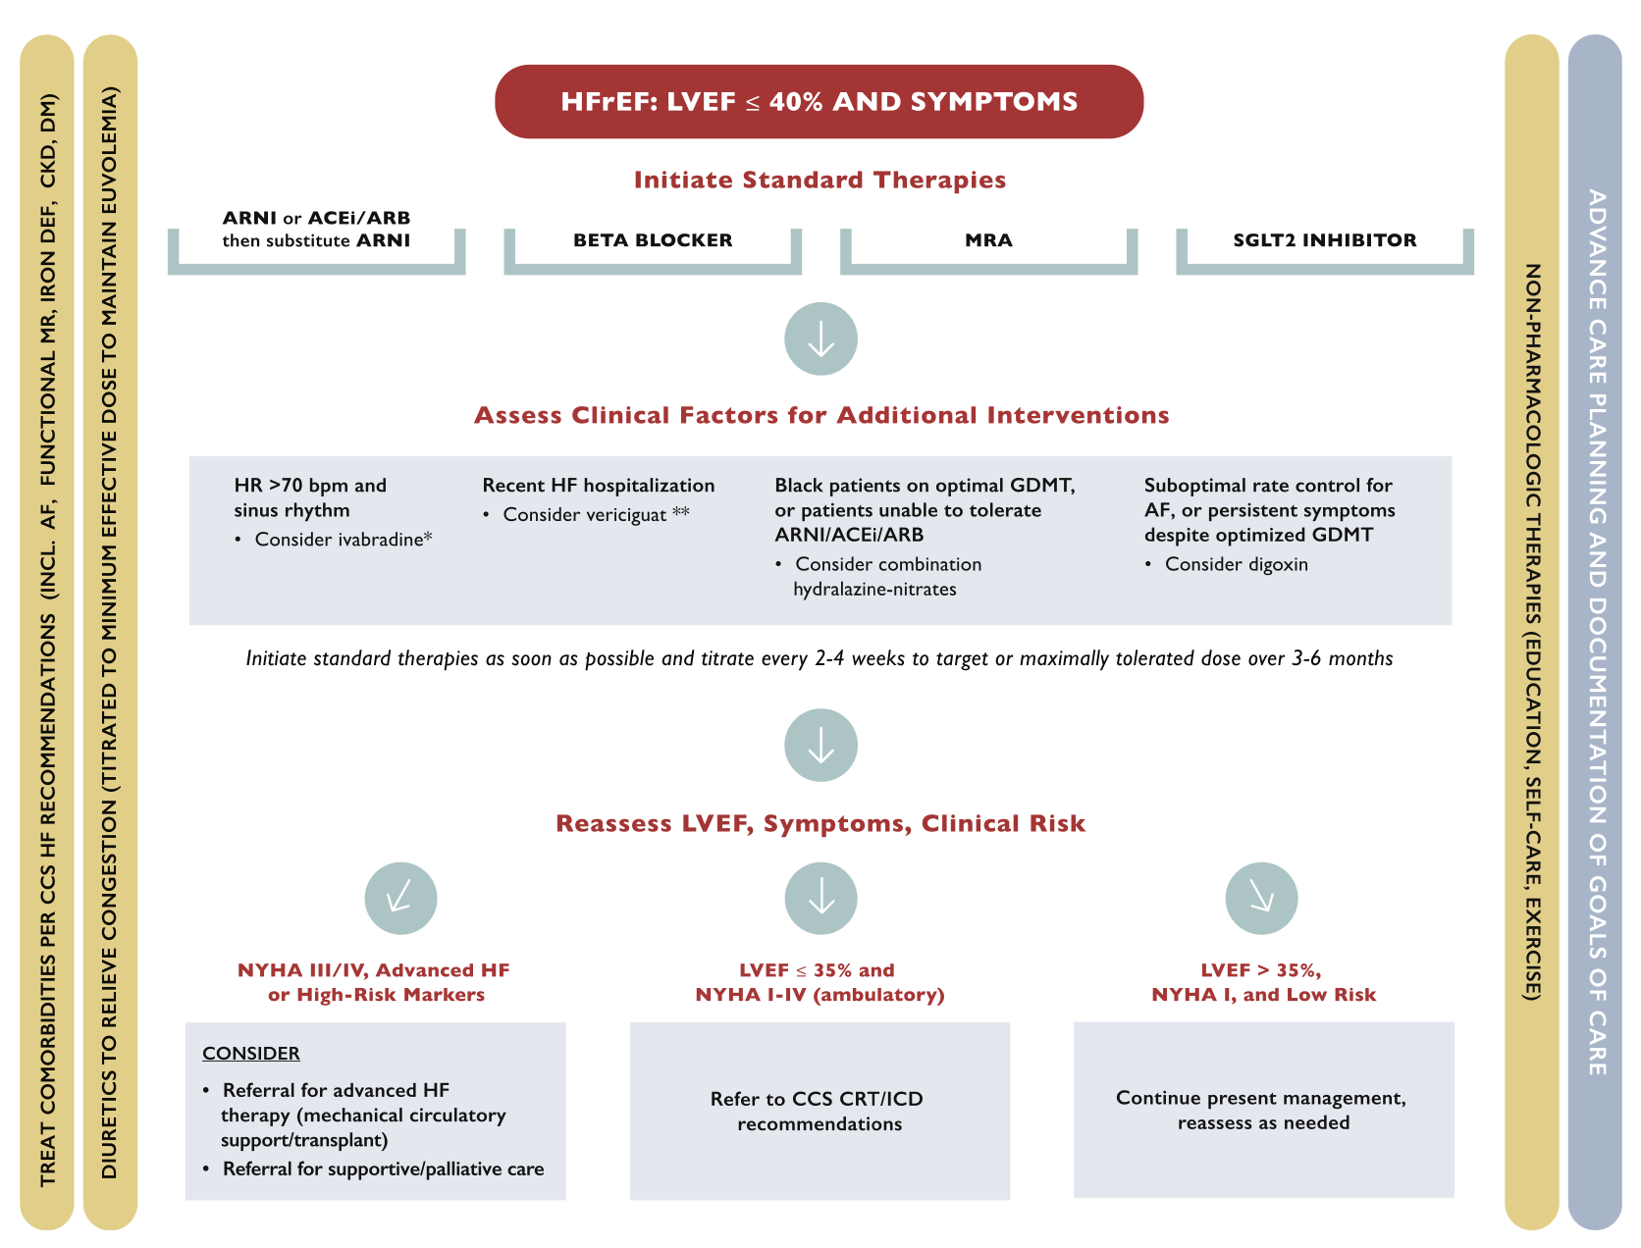
HF medication in acquired heart disease
McDonald M, et al. Can J Cardiol 2021;37:531-46

Slide 50
HF medication in Fontan circulation

Slide 51
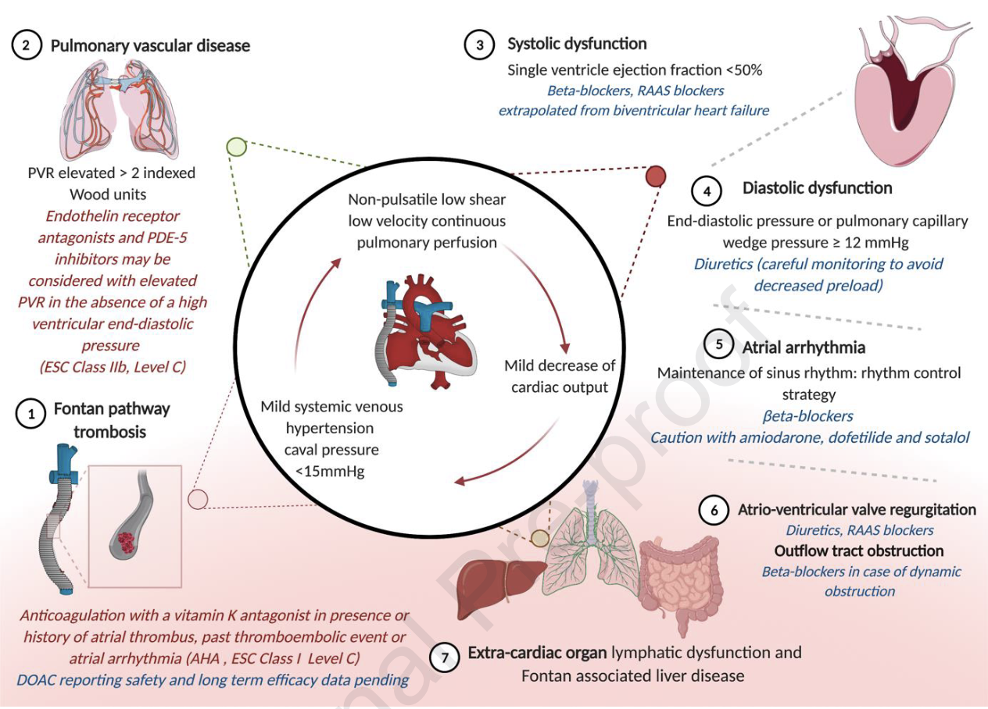
Nils P, et al. Can J Cardiol April 22,2022 - (In press)

Slide 53
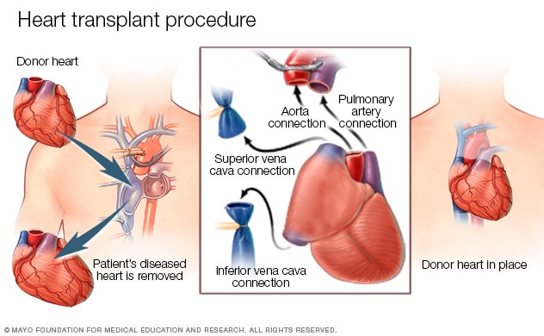

Slide 54
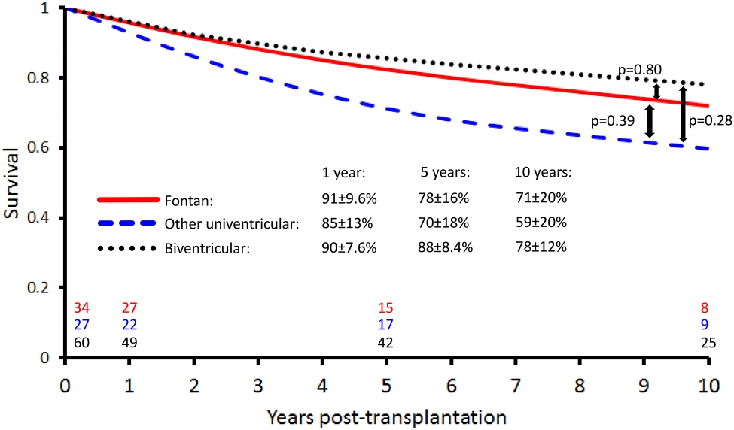
Transplant survival
Shi WY, et al. Heart 2016;102:1120–26

Slide 56
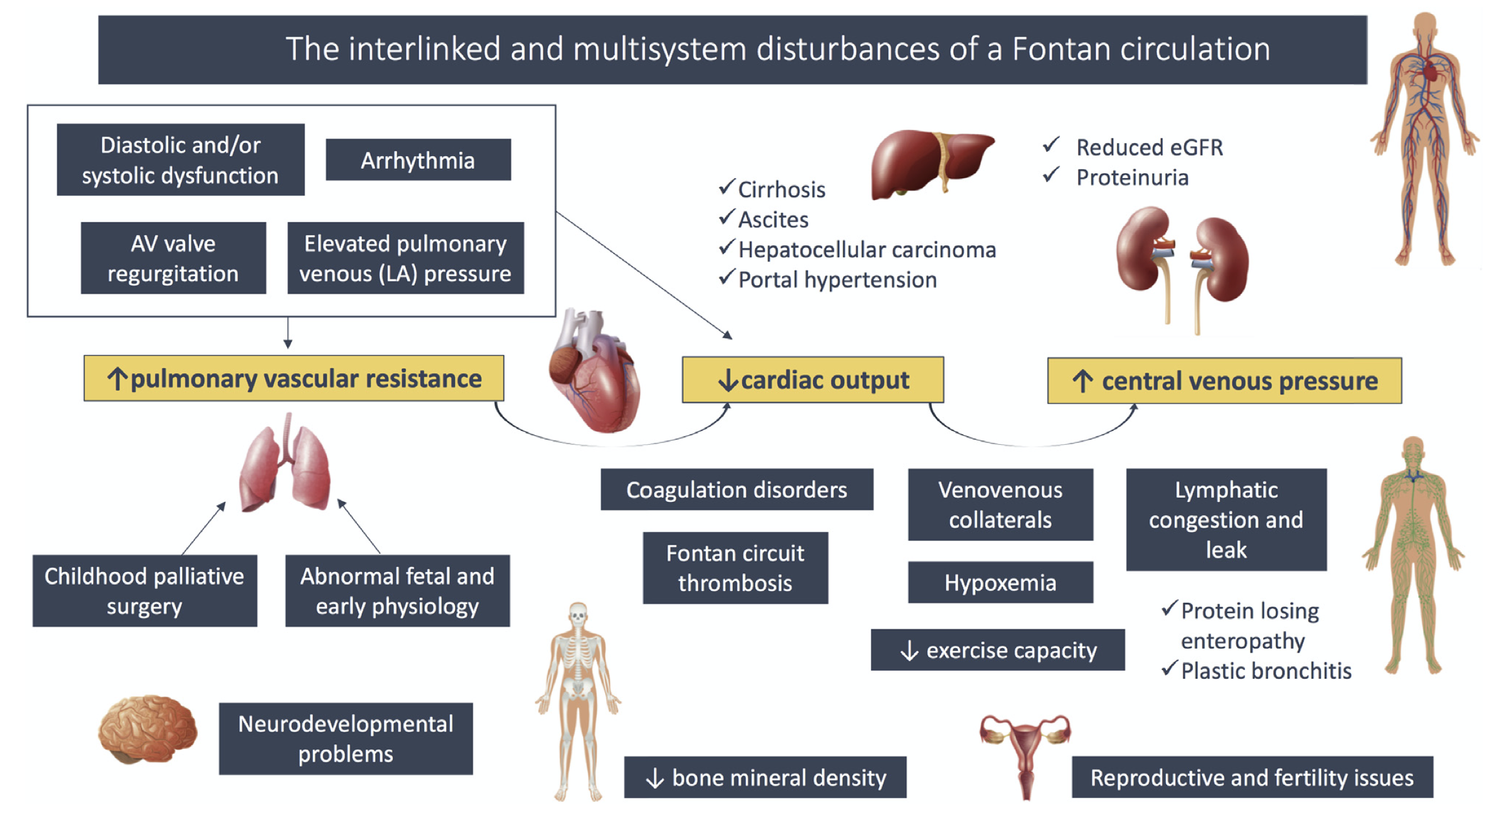
Laflamme E, et al. Can J Cardiol 2019;35:1631-34

Slide 57
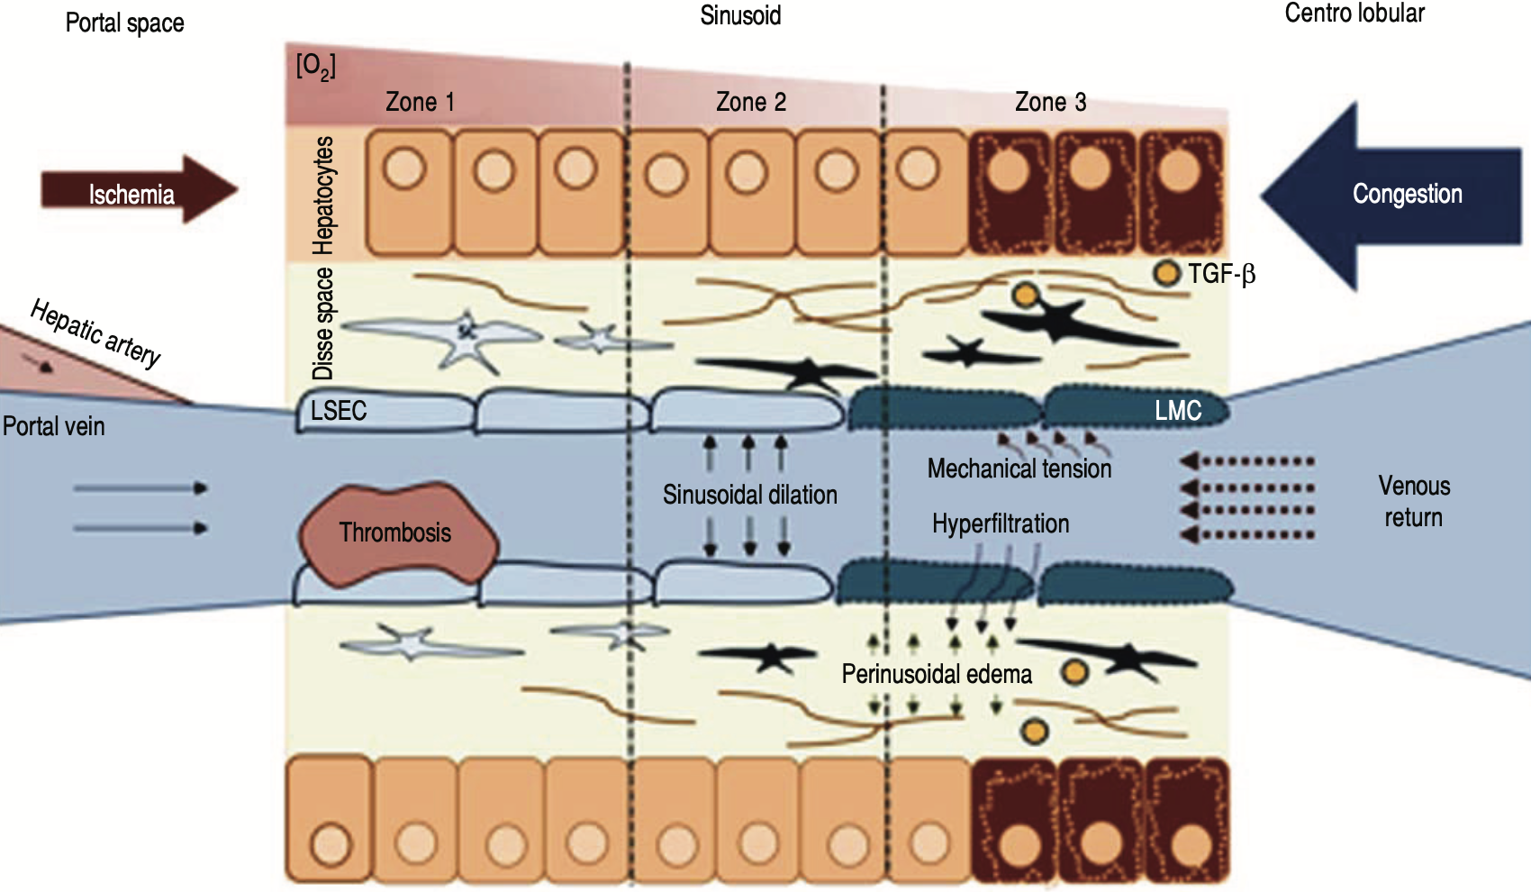
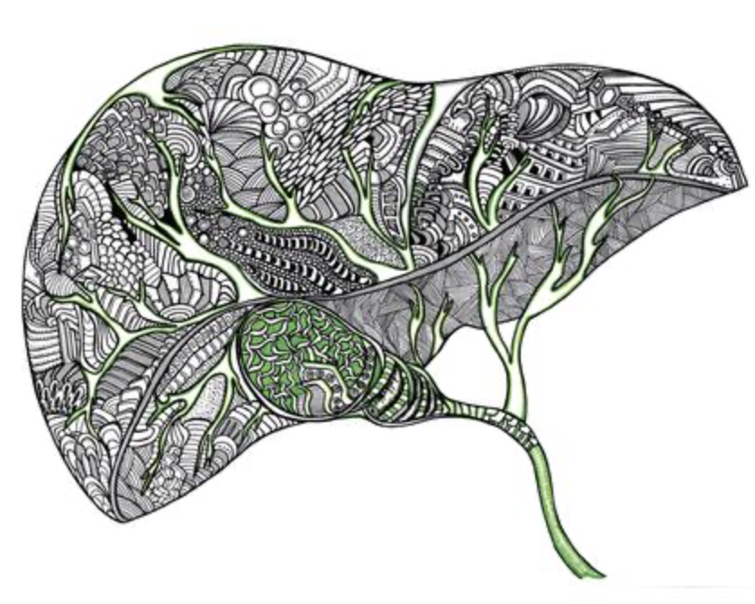
The liver
Tellez L et al. Ann Hepatol 2018;17(2):192–204

Slide 58
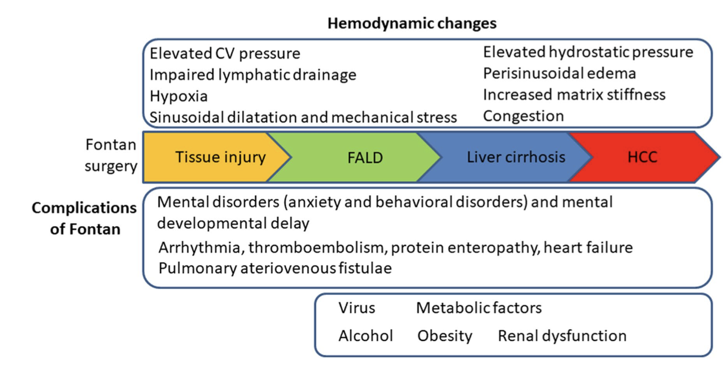
Hepatic dysfunction
Kogiso T, et al. Sci Rep. 2020;10:21742

Slide 59
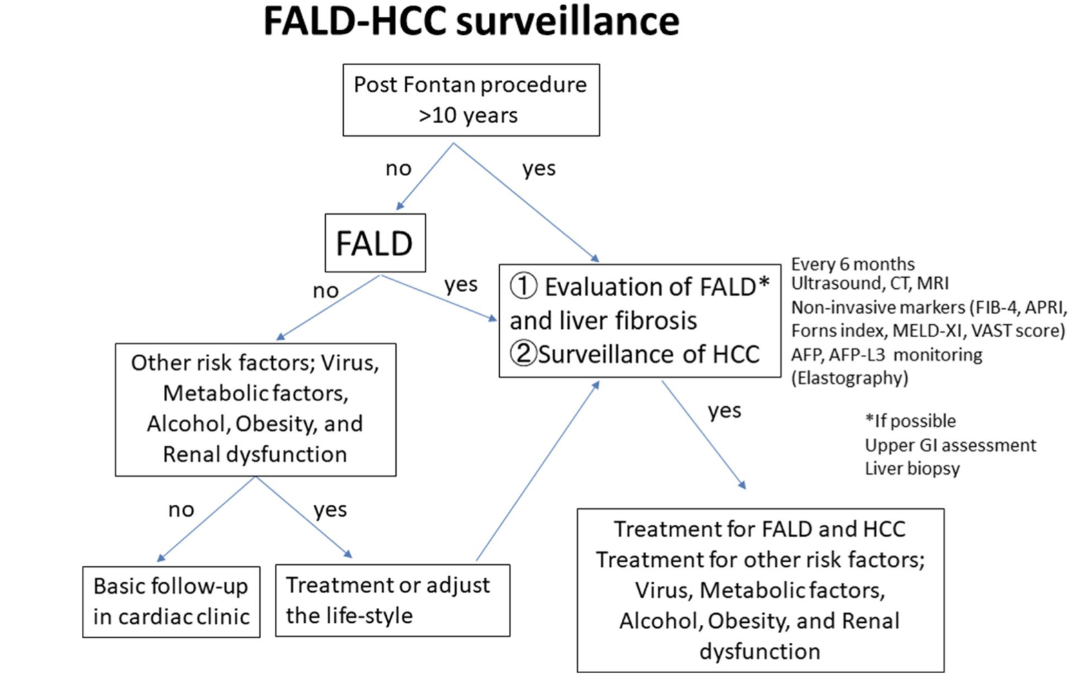
Kogiso T, et al. Sci Rep. 2020;10:21742

Slide 62
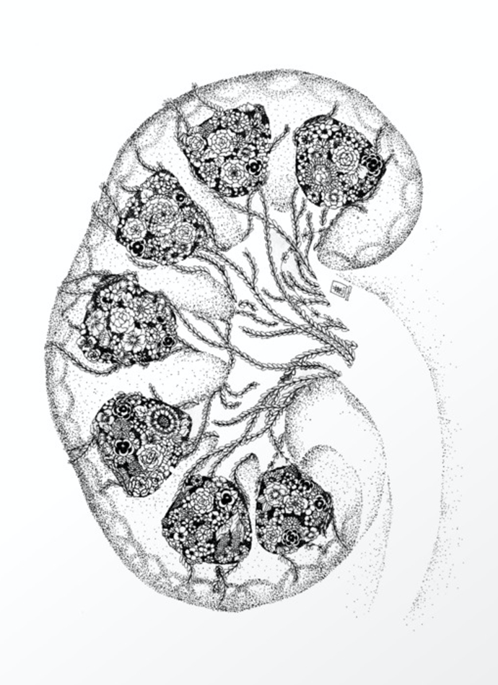
The kidneys
LABORATORY TESTING
Direct parameters
Urea
Creatinine
Creatinine clearance (24h urine)
Albumin
Cystatin C
Calculated parameters
eGFR
Urine albumin/Cr ratio (uACR)
BUN
Impaired eGFR - 10-15% Fontan patients
Albuminuria - 30% Fontan patients

Slide 63
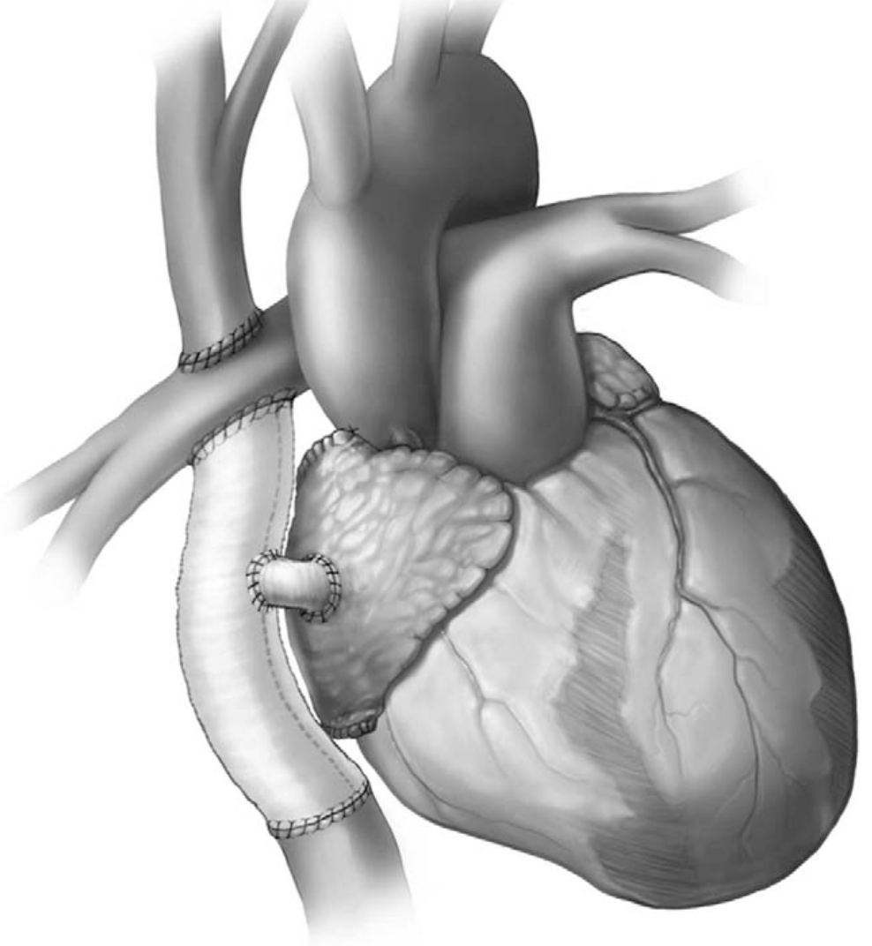
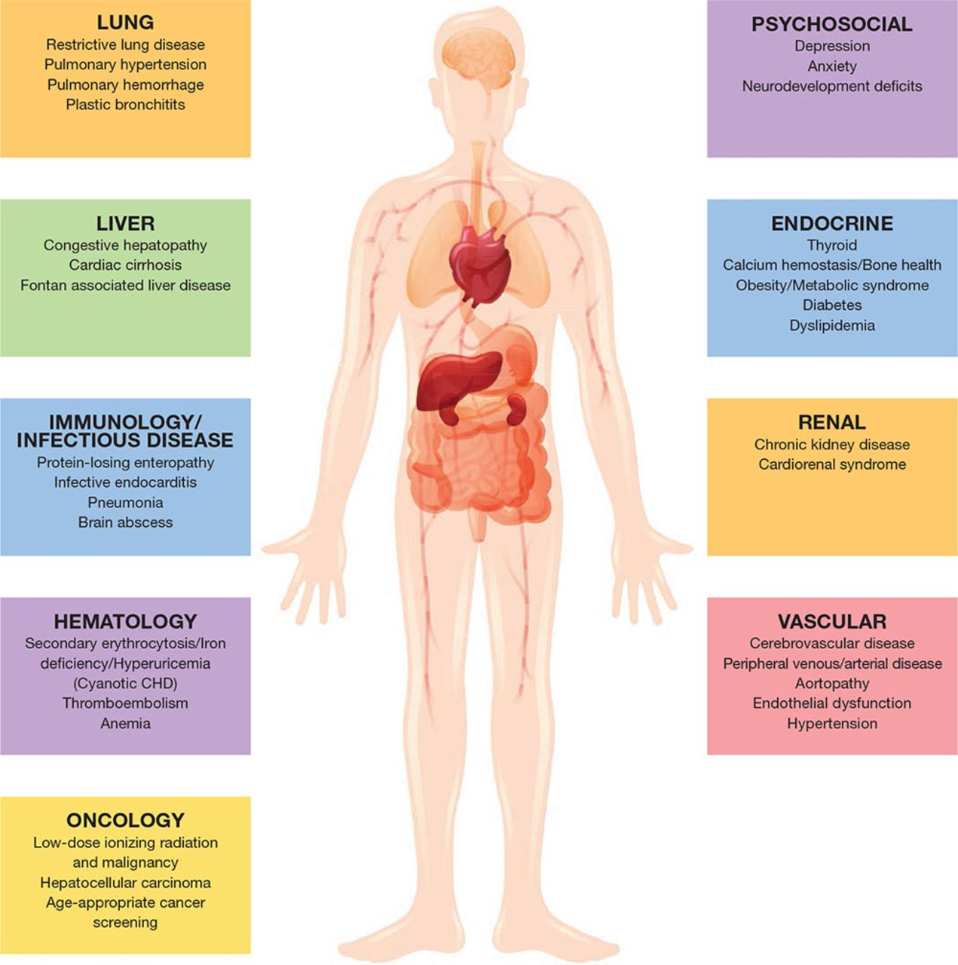
Fontan – multisystemic disease

Slide 65
LIFESTYLE CONSIDERATIONS
Navreet Gill, RN, MN
Sandra Aiello, RN

Slide 66
You’ve got the power to take control of managing your lifestyle.
Take charge by learning how certain lifestyle behaviours may impact your health.
Taking control and making good lifestyle choices, reduces your risk for developing other types of heart disease later in life.

Slide 67
01
Healthy Eating and Physical Activity
02
Oral Hygiene, Tattoos and Piercings
03
Alcohol
04
Smoking and Vaping
05
Marijuana and Illegal Drugs

Slide 68
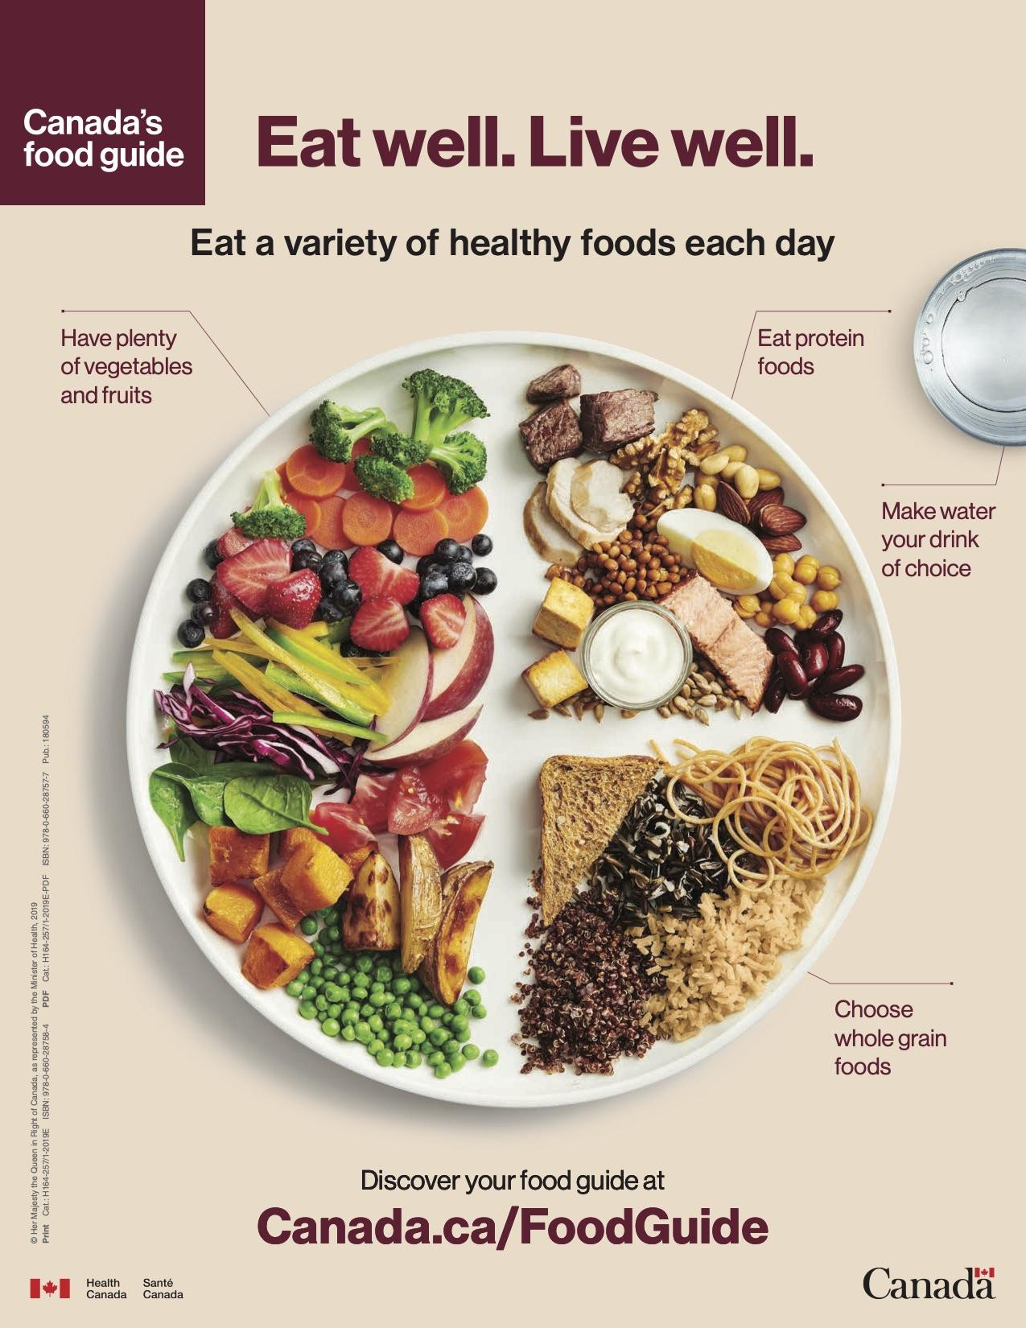
HEALTHY EATING and PHYSICAL ACTIVITY
THE GOAL: A healthy body weight
Being overweight can put a strain on your heart
Healthy eating and physical activity can significantly reduce your cardiovascular risks later in life (e.g., high blood pressure, stroke)
Speak to your cardiac team regarding any dietary or activity restrictions you may have

Slide 69
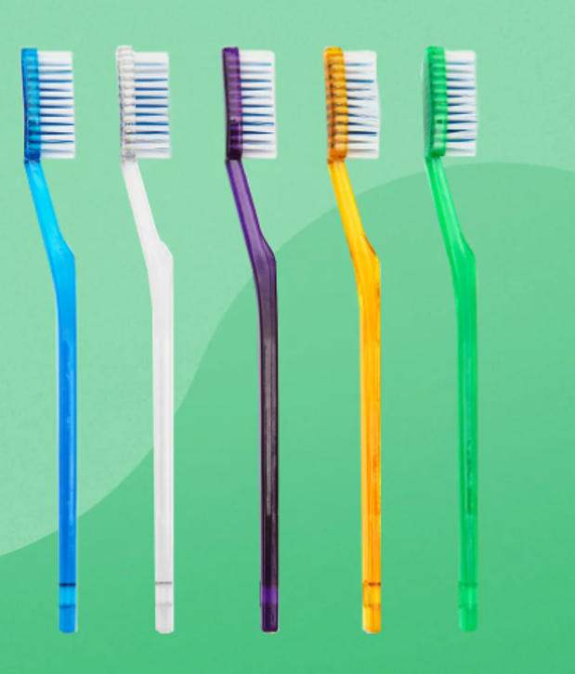
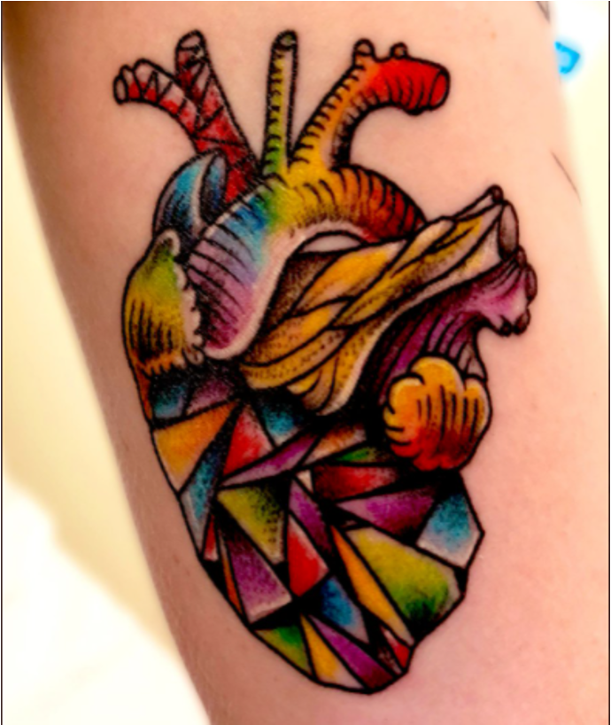
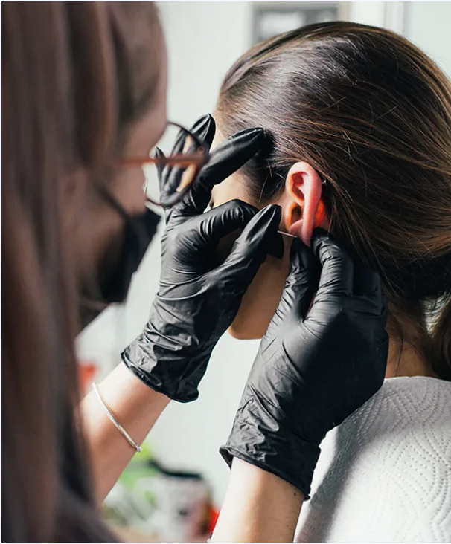
ORAL HYGIENE
Good oral health practices (i.e., regular dental check ups, flossing daily, and brushing your teeth twice daily) will reduce the likelihood of endocarditis
Make sure to know whether or not you require antibiotics prior to procedures
Speak to your cardiologist before getting a tattoo and/or piercing (location matters!)
Tattoos and anticoagulant medications - speak to your cardiologist
TATTOOS
PIERCINGS

Slide 70
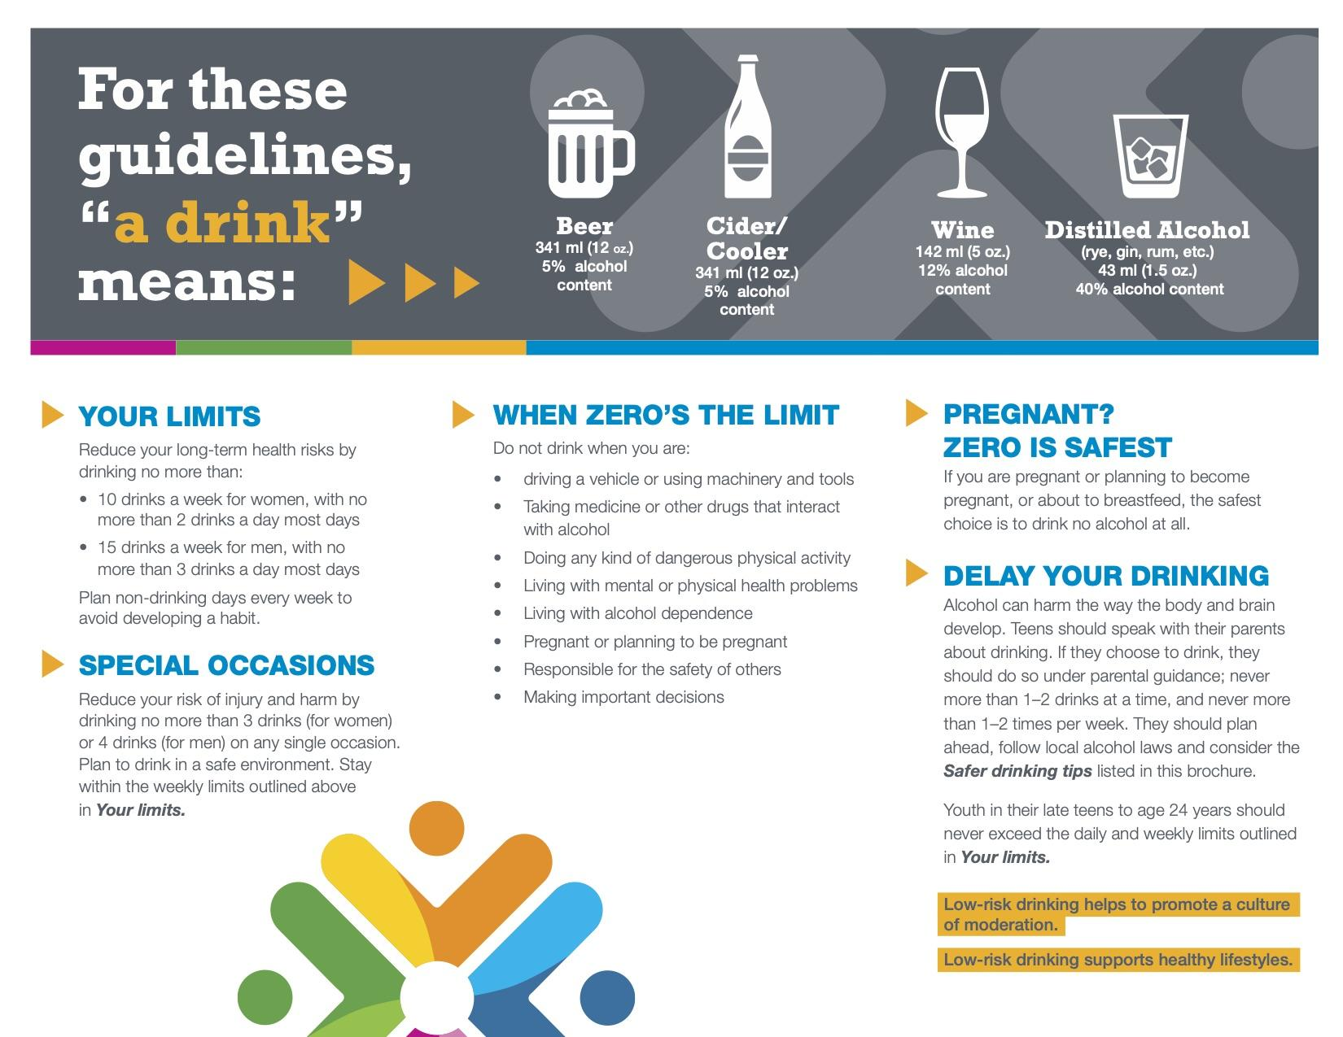
ALCOHOL
When of legal age, drinking in moderation is okay - drinking large amounts of alcohol (binge drinking) is not safe!
There are some people for whom even small amounts of alcohol are not safe. This includes some people with high blood pressure or some heart rhythm problems (arrhythmias).
Alcohol can affect the liver, and for some, may cause further liver damage.
Be aware of any interactions alcohol may have with medications.
Canadian Centre on Substance Use and Addiction, 2018

Slide 71
SMOKING and
VAPING
There are SHORT- AND LONG-TERM HEALTH RISKS associated with both smoking and vaping, these can include:
lung injury with evidence that it is related to one or more of the chemicals found in vaping solutions
negative impact on brain development (attention, learning, mood and impulse control)
nicotine addiction. Nicotine is toxic to the lungs and long-term use may increase the risk of chronic lung disease.
seizures

Slide 72
MARIJUANA
ILLEGAL DRUGS
widens blood vessels and make the heart pump harder & faster
impairs thinking, memory, and learning functions and affects how the brain builds connections
teens and young adults are at greatest risk of harm from using cannabis because their brains are still developing
Illegal drugs can:
make the heart beat faster and work harder
make the heart beat very slow leading to dizziness and fainting
cause life-threatening heart rhythms

Slide 73
Canada’s Food Guide
https://food-guide.canada.ca/en/
Physical Activity Guidelines - ParticipACTION
https://www.participaction.com/en-ca/benefits-and-guidelines/children-and-youth-age-5-to-17
https://www.participaction.com/en-ca/benefits-and-guidelines/adults-18-to-64
Oral Hygiene – Canadian Dental Association
http://www.cda-adc.ca/en/oral_health/cfyt/good_for_life/
Endocarditis
https://iheartchange.org/medical-info/avoiding-infections/
Substance Use (alcohol, cannabis, drugs)
https://www.canada.ca/en/health-canada/services/smoking-tobacco/vaping.html
https://www.canada.ca/en/services/health/campaigns/cannabis/health-effects.html
https://www.canada.ca/en/health-canada/services/substance-use/controlled-illegal-drugs.html
https://www.bhf.org.uk/informationsupport/support/children-and-young-people/managing-your-lifestyle/effects-of-smoking-and-drugs
Facts about mixing Medicine, Alcohol and Street Drugs
https://drugcocktails.ca
Resources

Slide 74
THANK YOU
Questions?

Slide 75
Fontan circulations and brain health
Thalia Field MD FRCPC MHSc
Neurologist, Vancouver Stroke Program
Associate Professor, Heart and Stroke/Sauder Family Professorship of Stroke Research, UBC

Slide 76
Brain health in adults with Fontan circulations:
Targeting stroke and changes in cognition
As people with Fontan circulations live longer and healthier lives, data about brain health across the lifespan continues to emerge
Brain development in utero and infancy
Changes in brain development patterns
Infancy and childhood
Surgeries, procedures, education disruption from hospitalizations, psychological trauma

Slide 77
Brain health in adults with Fontan circulations:
Targeting stroke and changes in cognition
Growing older with Fontan circulations
Heart structure and function
Systemic health
Potential threats from clots, changes in blood flow and oxygenation, inflammation
Age-related brain changes

Slide 78
Knowledge gaps and Research Priorities
How does brain health change over time in people with Fontan circulations?
Which timepoints and events along the lifespan may modify these changes, and how do they relate to specific risk factors?
What are the ways in which brain health may be threatened over the lifespan, how are these threats modified by early-life brain development, and how do they represent opportunities for prevention?
How can we study brain health over time in a sustainable way in people with Fontan circulations?
What are YOUR priorities in learning about brain health and the best ways to learn new info?
Brain changes

Slide 79
Knowledge gaps and Research Priorities
How does brain health change over time in people with Fontan circulations?
Which timepoints and events along the lifespan may modify these changes, and how do they relate to specific risk factors?
What are the ways in which brain health may be threatened over the lifespan, how are these threats modified by early-life brain development, and how do they represent opportunities for prevention?
How can we study brain health over time in a sustainable way in people with Fontan circulations?
What are YOUR priorities in learning about brain health and the best ways to learn new info?
Brain changes

Slide 80
Knowledge gaps and Research Priorities
How does brain health change over time in people with Fontan circulations?
Which timepoints and events along the lifespan may modify these changes, and how do they relate to specific risk factors?
What are the ways in which brain health may be threatened over the lifespan, how are these threats modified by early-life brain development, and how do they represent opportunities for prevention?
How can we study brain health over time in a sustainable way in people with Fontan circulations?
What are YOUR priorities in learning about brain health and the best ways to learn new info?
Brain changes

Slide 81
Knowledge gaps and Research Priorities
How does brain health change over time in people with Fontan circulations?
Which timepoints and events along the lifespan may modify these changes, and how do they relate to specific risk factors?
What are the ways in which brain health may be threatened over the lifespan, how are these threats modified by early-life brain development, and how do they represent opportunities for prevention?
How can we study brain health over time in a sustainable way in people with Fontan circulations?
What are YOUR priorities in learning about brain health and the best ways to learn new info?
Brain changes

Slide 82
The SEARCH study
We want to learn about how brain health and cognition may change over time in order to identify the best opportunities for prevention, and determine what protective factors may be in people with good brain health
We will understand what the role may be for routine brain imaging and cognitive assessment as part of usual clinical care
3-year study: MRI (Baseline and Year 3) and cognitive testing (every year) to assess brain health, special blood tests looking for brain proteins
Medical history, bloodwork, echo, holter to assess for risk factors

Slide 84
Break - 10 MINUTES
This is a good time to add your questions in the chat:
If you are stepping away from your device, remember to mute your audio and video:

Slide 85
Breakout Group Sessions
You will be assigned to your breakout group momentarily!

Slide 87
Resources
Where to find information for Fontan
patients and caregivers/family members:
Your CHD clinic/hospital staff
Your GP/PCP/ Family doctor

Slide 88
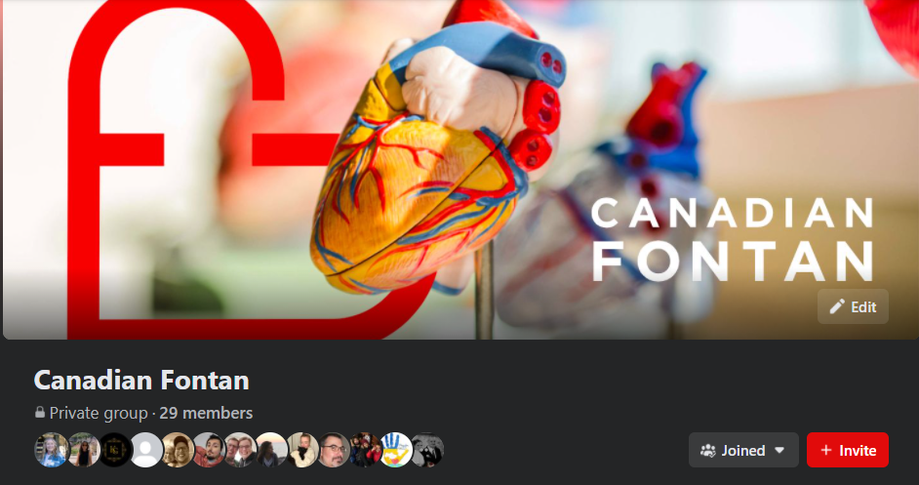
Resources
Canadian Fontan
Website
https://canadianfontan.com/
Facebook Group
Peer to peer support and resource Sharing
Click here to join or search for “Canadian Fontan” on Facebook (be sure to answer all the screening questions and agree to group rules)

Slide 89
Resources
Canadian Congenital Heart Alliance (CCHA): https://www.cchaforlife.org/
Adult Congenital Heart Alliance (ACHA): https://www.achaheart.org/
Social media “support” groups
Ex: Zipper Sisters Facebook Group

Slide 90
Resources
Virtual Fontan Camp: https://www.facebook.com/VirtualFontanCamp/

Slide 91
Resources
Books/Literature to consider:
Canadian Journal of Cardiology https://www.onlinecjc.ca/
Open Heart by Stephen Westaby. Technical yet inspiring from a surgeons perspective.
Heart: A History by Sandeep Jaguar. Incorporates more acquired heart disease background/treatments.
The Source of All Things by Reinhold Friedl. Blends philosophy with medical & spiritual inquiry into the nature of the heart from a cardiologist who wanted to investigate from a bigger perspective.
The Open Heart Club by Gabriel Brownstein. A man born with Tetralogy of Fallot (TOF) writes of his experiences.

Slide 92
HOPE YOU ALL ENJOYED YOUR TIME TOGETHER!
BIG THANK YOU!!!!!

Slide 93
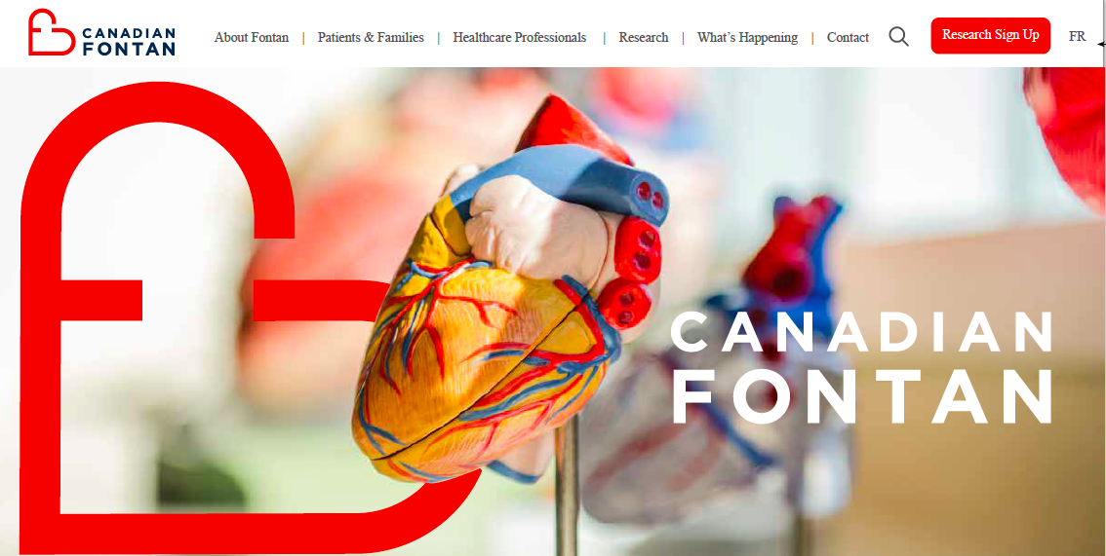
www.canadianfontan.com

Slide 94
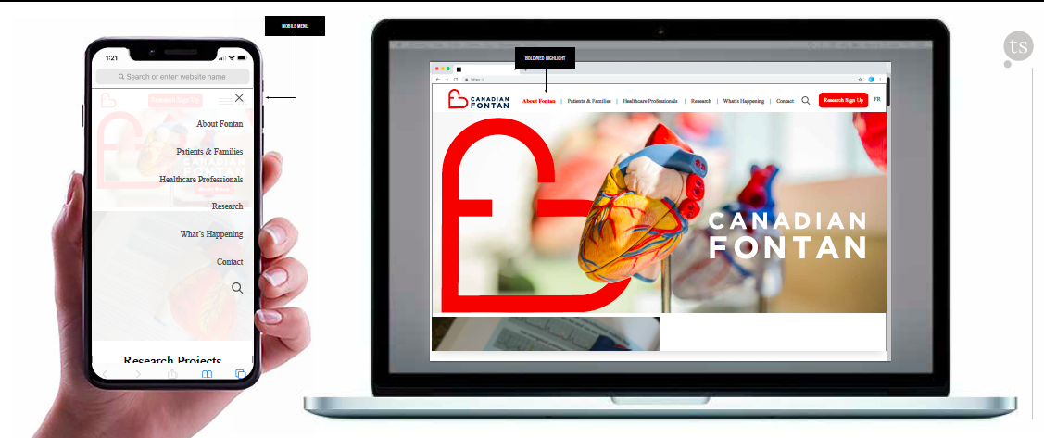
www.canadianfontan.com

Slide 95
Canadian Fontan Facebook Group
Peer to peer support and resources

Slide 96
Thank you!
If interested…
you can also contact
PACHResearch@ProvidenceHealth.bc.ca

Slide 97
Notes:
This is a slide from CCHA to promote the Virtual Fontan Heart Camp

